Slide 1
Engineering Thermodynamics (ET)
CUPGS Rourkela
Introduction to Engineering Thermodynamics
🞄 Thermo + Dynamics
🞄 Thermo : meaning is hot or heat
🞄 Dynamics : meaning is power or powerful, the study of matter in motion.
🞄 Thermodynamics means study of heat related to matter in motion.

Slide 2
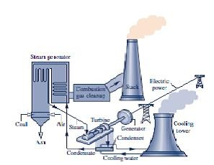
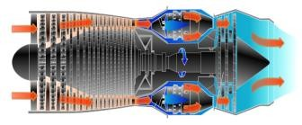


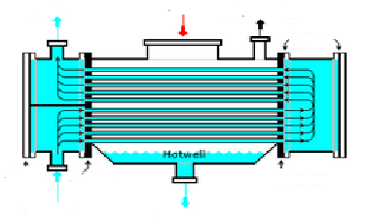

🞄 Automobile engines
🞄 Turbines, compressors and pumps
🞄 The propulsion system for aircrafts and rockets
🞄 Combustion system
🞄 HVAC system
🞄 Cooling of electronic equipments
🞄 Power stations
🞄 Alternative energy system like, geothermal, wind, solar, etc.
🞄 Cryogenic system
Applications of Engineering Thermodynamics
Turbo Engine
Refrigerator
Power Plant
Applications of Engineering Thermodynamics
Space applications
Heat Exchanger
I C Engine

Slide 3
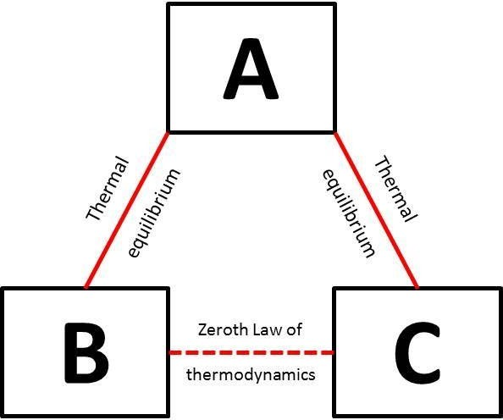
18-01-2024
Laws of Thermodynamics
🞄 Zeroth law of thermodynamics
🞄 First law of thermodynamics
🞄 Second law of thermodynamics
🞄 Third law of thermodynamics
Laws of Thermodynamics
Zeroth law of thermodynamics

Slide 4
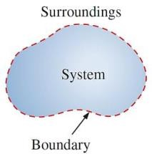
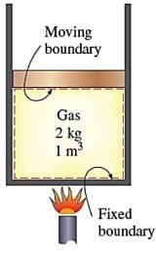
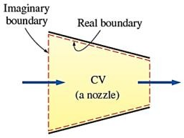
18-01-2024
Thermodynamic system
Surrounding
Boundary
🞄 System:
It is defined as a quantity of matter or a region in space on which attention is focused/ selected for study.
🞄 Surrounding or environment:
It is the matter or region outside the system.
🞄 Boundary:
A line or surface, actual or imaginary
which separates the system from its surrounding.
🞄 Universe:
The combination of system and The surroundings together is
usually referred to as the universe.
Types of Boundary
🞄 Fixed or Moving Boundary
🞄 Real or Imaginary Boundary

Slide 5
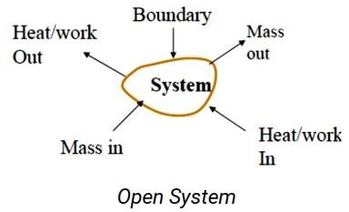
18-01-2024
🞄 Open system:
In an open system, mass and energy (in the form of heat and work) both can transfer across the boundary.
Types of Thermodynamic systems
Most of the engineering devices are open systems.
Examples: Boiler, Turbine, Compressor, Pump, I.C. Engine, etc.
🞄 Closed system:
A closed system can exchange energy in the form 0f heat and work with its surroundings but there is no mass transfer across the system boundary.
Types of Thermodynamic systems
The mass within the system remains constant however its volume can change against a flexible boundary.
Examples: Cylinder bounded by a piston with certain quantity of fluid, pressure cooker and Bomb calorimeter, etc.

Slide 6
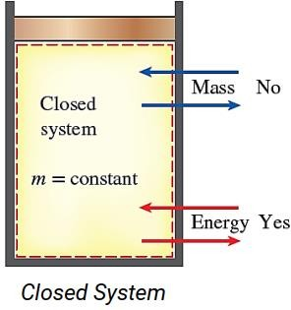
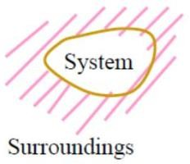
18-01-2024
🞄 Closed system:
A closed system can exchange energy in the form 0f heat and work with its surroundings but there is no mass transfer across the system boundary.
Types of Thermodynamic systems
🞄 Isolated system:
There is no interaction between the system and surroundings.
Types of Thermodynamic systems
It is of fixed mass and energy, and hence there is no mass and energy transfer across the system boundary.
Examples: The universe and perfectly insulated closed vessel (Thermo flask).

Slide 7
18-01-2024
Phase
🞄 Phase:
It is the quantity of matter which is homogeneous throughout in chemical composition and physical structure.
Examples: Solid, liquid, gas.
Types of Thermodynamic systems
🞄 Homogeneous system:
A system which consists of a single phase is termed as homogeneous system.
Examples: Mixture of air and water vapour, water plus nitric acid, Octane plus hectane.
🞄 Heterogeneous system:
A system which consists of two or more phases is called heterogeneous system.
Examples: Water + steam, Ice + water, Water + oil.

Slide 8
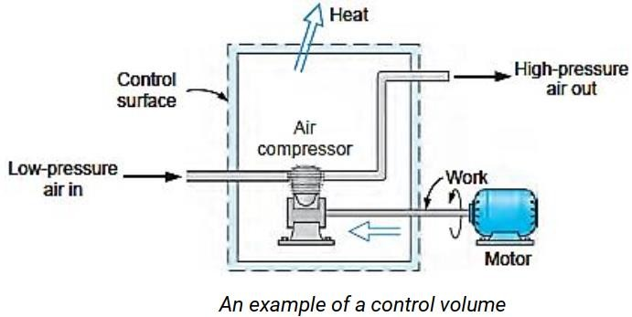
18-01-2024
Control Volume and control surface
🞄 Control Volume:
For thermodynamic analysis of an open system, such as an air compressor, turbine, etc. the mass of the system is not fixed. So, attention is focused on a certain volume in space surrounding the system, known as Control Volume (Fixed volume of given mass)
🞄 Control surface:
The control volume bounded by the surface is known as Control Surface.
Control Volume and control surface

Slide 9
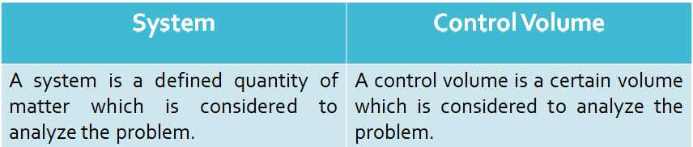
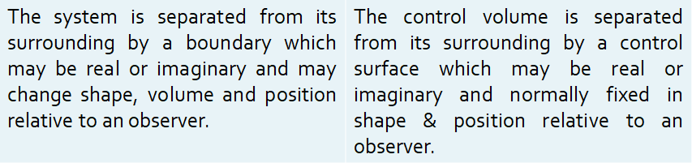
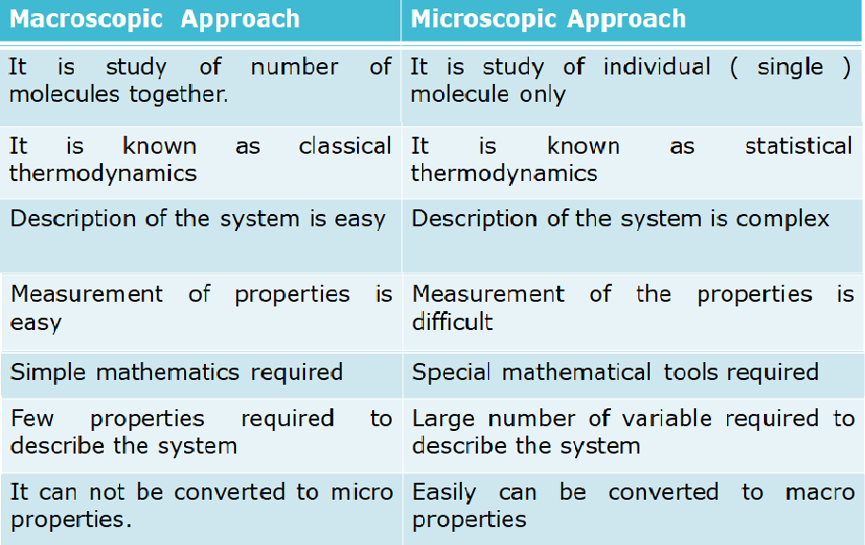
18-01-2024
Difference between system and control volume
Differentiate Macroscopic and Microscopic Approach.

Slide 10
18-01-2024
 | Macroscopic Approach | Microscopic Approach
 | It is study of number of molecules together. | It is study of individual ( single ) molecule only
Differentiate Macroscopic and Microscopic Approach.
 | It is known as classical thermodynamics | It is known as statistical thermodynamics
 | Description of the system is easy | Description of the system is complex
 | Measurement of properties is easy | Measurement of the properties is difficult
 | Simple mathematics required | Special mathematical tools required
 | Few properties required to describe the system | Large number of variable required to describe the system
 | It can not be converted to micro properties. | Easily can be converted to macro properties
 | Generally represents average/overall values. | Generally represents for single molecules.
Thermodynamic
Properties
🞄 Thermodynamic Properties:
A measurable quantities which describe the state of system or a physical condition is known as Property of the system.
🞄 Intensive Properties:
These properties do not depends on mass of the system. Examples: temperature, pressure, specific heat, specific volume, specific enthalpy.
🞄 Extensive Properties:
These properties depends on the mass of the system. Examples: volume, mass, total energy, total enthalpy,

Slide 11
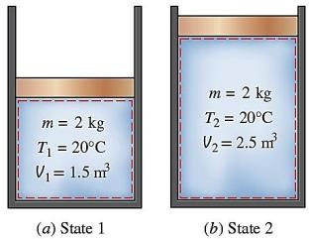
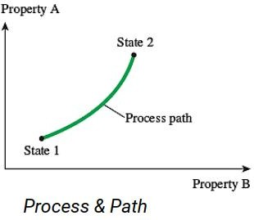
18-01-2024
🞄 State:
The physical condition of the system at an instant of time as described by its properties (Measurable quantities) is known as state of the system.
State, process and cycle
🞄 Process:
The transition (change) of the state is known as process or state change.
State, process
and cycle
🞄 Path:
It is series of states through which a system passes during a process.

Slide 12
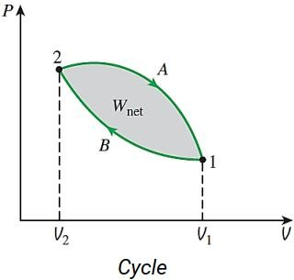
18-01-2024
State, process and cycle
🞄 Cycle:
A series of processes in which initial and final state of the system are same is known as cycle.
Thermodynamic
Equilibrium
🞄 Thermodynamic Equilibrium:
A system is said to be in a state of thermodynamic equilibrium if the values of properties are the same at all points in the system.
🞄 Types of Equilibrium systems:
🞄 Thermal Equilibrium
🞄 Mechanical Equilibrium
🞄 Chemical Equilibrium

Slide 13
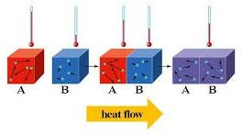
18-01-2024
Thermodynamic Equilibrium
🞄 Thermal Equilibrium:
If the temperature of the system does not change
with time and has same value at all points of the system, the
system is said to be in thermal equilibrium.
Thermodynamic
Equilibrium
🞄 Thermal Equilibrium:

Slide 14
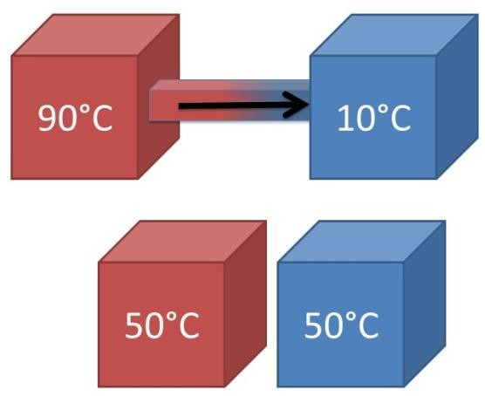
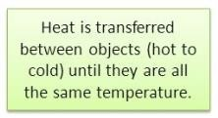
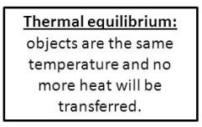
18-01-2024
Thermodynamic Equilibrium
🞄 Thermal Equilibrium:
Thermodynamic
Equilibrium
🞄 Mechanical Equilibrium:
A system is in mechanical equilibrium if there are no unbalanced forces within the system or between surroundings. The pressure in the system is same at all points and does not change with respect to time.

Slide 15


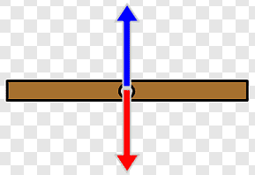

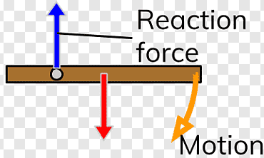
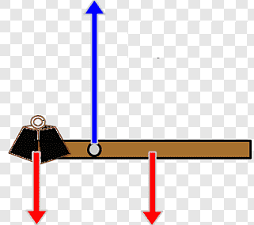
18-01-2024
Thermodynamic Equilibrium
🞄 Mechanical Equilibrium:
🞄 Mechanical Equilibrium:
Thermodynamic
Equilibrium

Slide 16
18-01-2024
Thermodynamic Equilibrium
🞄 Chemical Equilibrium:
A system is in chemical equilibrium if its chemical composition does not change with time and no chemical reaction takes place in the system.
C O2 CO2 CO2
O2
C
CO2
CO2
C
O2
CO2
CO2
Quasi–static
process
🞄 Quasi means almost and static mean too slow or infinitely slow.
🞄 When Process proceeds in such a way that the system remains close to a thermodynamic equilibrium state at all times, it is known as Quasi – Static process.
🞄 Examples:
🞄 Iso-thermal process : (Temp. is constant)
🞄 Iso-baric process : (Pressure is constant)
🞄 Iso-choric process: (Volume is constant)

Slide 17
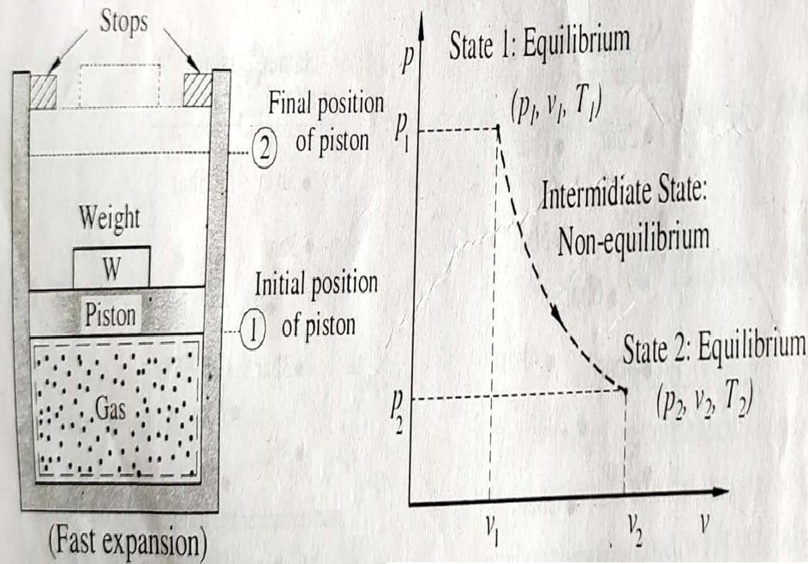
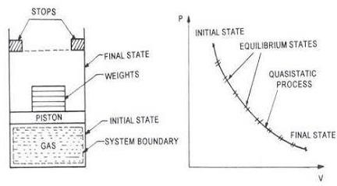
18-01-2024
Quasi – static process
Quasi – static
process

Slide 18
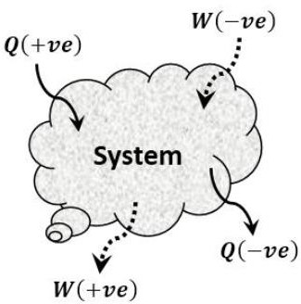
18-01-2024
Heat and Work
🞄 Heat is defined as the form of energy that is transferred between two systems by virtue of a temperature difference.
🞄 Work is defined as an energy interaction between a system and its surroundings during a process can be considered as work transfer if its sole effect on everything external to the system could have been to raise the weight.
Sign conversion for Heat and Work

Slide 19

18-01-2024
Different forms of Work transfer
🞄 Mechanical Work
🞄 Thermodynamic work
🞄 Electrical work
🞄 Displacement work
Different forms
of Work transfer
🞄 Mechanical Work:
It is the product of an external force acting at the boundaries of the system and the distance through which force moves along its line of action.
In mechanics work done by a system is expressed as a
product of force (F) and displacement (s)
If the force is not constant, the work done is obtained by adding the differential amounts of work,

Slide 20
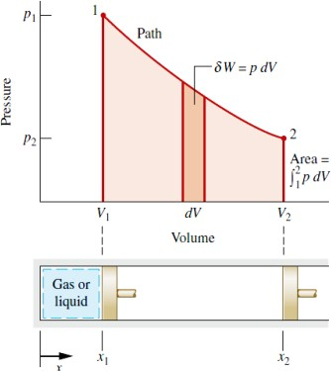
18-01-2024
Different forms of Work transfer
🞄 Displacement Work / Pdv Work:
Different forms
of Work transfer
🞄 Displacement Work / pdV Work:
δW = force x distance moved
= (pressure x cross section area) x distance moved
= p . A dx
= p dV where, dV = A dx = infinitesimal swept volume

Slide 21
18-01-2024
Pure Substance
🞄 A substance that has a fixed chemical composition throughout is called pure substance. Example: Water, nitrogen, helium, carbon dioxide etc.
🞄 The pure substance must be satisfy conditions:
🞄 Homogeneous in composition
🞄 Homogeneous in chemical aggregation
🞄 Invariable in chemical aggregation
the following three
Numerical 1
🞄 The piston of an oil engine of area 0.005 m² moves down to 8 mm drawing fresh air from atmosphere. Calculate the displacement work done by the piston. During the process, pressure is constant as 0.82 bar.
Given data: A = 0.0005 m²
x = 8 mm = 0.008 m
p = 0.82 bar = 0.82 x 10⁵ N/m² W = ?

Slide 22
18-01-2024
Numerical 1
🞄 Displacement work done on system
= ∫ p dV
= p x (V₂ – V₁)
= 0.82 x 10⁵ (A x L – 0)
= 0.82 x 10⁵ x 0.005 x 0.008
= 3.28 J
Numerical 2
🞄 A gas undergoes a quasi-static non flow process according to p
= 5V – 8 bar, where V is volume in m³ and p is pressure in bar. Calculate the work done when the volume changes from 2 to 3 m³.
Given data:
p = 5V - 8 bar V₁ = 2 m³
V₂ = 3 m³ W = ?

Slide 23


18-01-2024
Numerical 2
🞄 Displacement work done on system W = ∫ p dV
𝑉₂
= න 5𝑉 − 8 × 10⁵ × 𝑑𝑉
𝑉₁
=
5𝑉²
2
− 8𝑉 × 10⁵
𝑉=3𝑚³
𝑉=2𝑚³
=
5 5
× 3² − × 2² − 8 − 3 + 8 × 2
× 10⁵
2
2
= 𝟒. 𝟓𝑱
Numerical 3

Slide 24
18-01-2024
Numerical 4
1 kg gas is contained in a piston cylinder arrangement at a pressure 8 bar and volume 0.045 m³. The fluid is allowed to expand reversibly according to pV^{1.8} = C until the volume becomes two times of its initial value. The fluid is then cooled reversibly at constant pressure until the piston reaches its original position. Finally, the heat addition take place until the gas pressure increases to initial pressure. Calculate net work done by gas during the cycle.
Numerical 4
Given data:
m = 1 kg p₁ = 8 bar
V₁ = 0.045 m³ pV^{1.8} = C
V₂ = 2V₁
W_{net} = ?

Slide 25
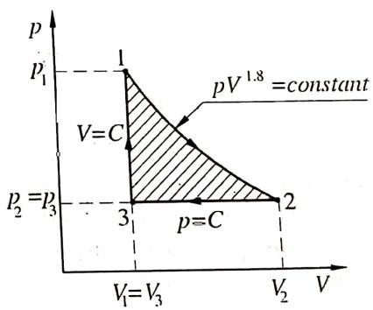


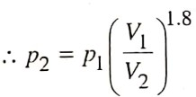









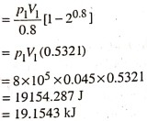


18-01-2024
Numerical 4
Numerical 4

Slide 26
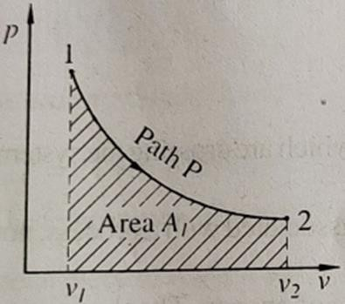
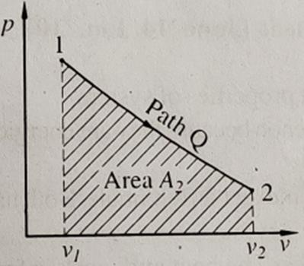
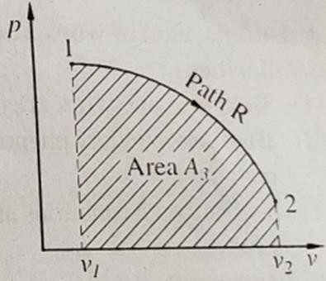
18-01-2024
Point function and Path function
🞄 Point Function: The property of system which does not depends on path of process, but depends on states (two end conditions of process), this property is called as point function.
🞄 Example: pressure, temperature, volume
🞄 Path Function: There are certain quantities which cannot be located on a graph by a point but are represented by the area on that graph.
🞄 Those quantities are dependent on the path of the process and are called path function.
🞄 Example: work, heat
Point function and Path function

Slide 27
18-01-2024
Temperature Scale
🞄 Temperature scales enable us to use common basis for temperature measurements and several temperature scales have been introduced so far.
🞄 All temperature scales are based on some easily reproducible states such as freezing and boiling point temperatures of water
i.e. ice point and steam point respectively.
🞄 The temperature scale used in SI units is the Celsius scale. On the Celsius scale, ice point and steam point are assigned the numerical values of 0 and 100 ⁰C respectively.
🞄 The English system uses the Fahrenheit scale, which assigns 32
and 212 ⁰F as the ice point and steam point respectively.
Temperature
Scale
🞄 A more useful temperature scale in thermodynamics is the absolute temperature scale and is called the Kelvin scale. The temperature unit on this scale is Kelvin, designated as K, without the degree symbol.
🞄 The Kelvin scale is related to Celsius scale by,
T (K) = T (⁰C) + 273.15

Slide 28
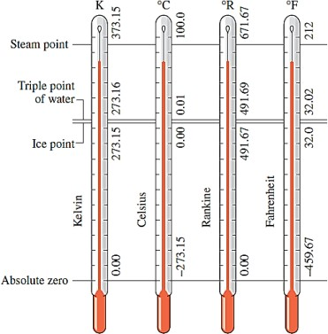
18-01-2024
Temperature Scale
Concept of
Continuum
🞄 Continuation of matter
🞄 It brings together Macroscopic and Microscopic approach.
🞄 The mass distribution is not uniforms.
🞄 Voids/gaps are existing between molecules.
🞄 Substance is viewed to be continuous and homogeneous
🞄 No microscopic gaps or holes
🞄 Pressure and temperature as large no. of molecules
🞄 Continuous system
🞄 Not applicable when numbers of molecules in the system are very small

Slide 29
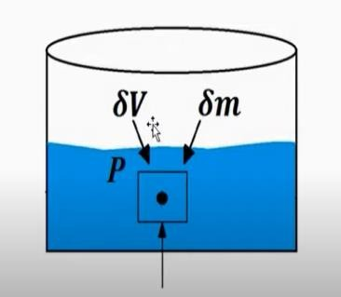
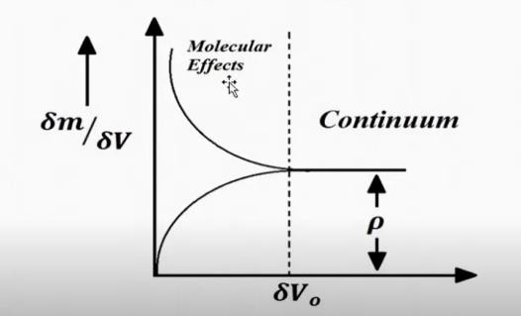
18-01-2024
Concept of Continuum
Knudsen Number, Kn = λ /L
Where,
λ = average distance between two molecules L = Largest dimension of the system
The limiting value of Kn ≤ 0.1.
Numerical 5
A piston cylinder device operates 1 kg of fluid at 20 atm. Pressure. The initial volume is 0.04 m³. The fluid is allowed to expand reversibly following a process pV^{1.45} = Constant so that the volume becomes double. The fluid is then cooled at constant pressure until the piston comes back to the original position. Keeping the piston unaltered, heat is added reversibly to restore it to the initial pressure. Calculate work done in the cycle.

Slide 30
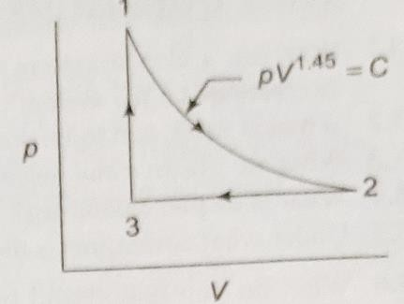
18-01-2024
Numerical 5
Given data:
m = 1 kg
p₁ = 20 atm. = 20 x 1.01325
= 20.265 bar = 20.265 x 10⁵ N/mm² V₁ = 0.04 m³
_{pV}1.45 _{= C}
V₂ = 2V₁
W_{net} = ?
Numerical 4
🞄 For process 1 – 2,
P ⎛ V ⎞^{n}
2 _{= ⎜} 1 ⎟
P₁
⎝ ^{V}2 ⎠
⎛ V ⎞^{n}
_{⎛ 1 ⎞}1.45
P₂ = ⎜ ¹ ⎟ .P₁ = ⎜
⎟
× 20.265
⎝ ^{V}2 ⎠
⎝ 2 ⎠
= 7.417bar
p V − p V
100[20.265× 0.04 − 7.417 × 0.08]
_{W1−2 =} 1 1 2 2 ₌
n −1 0.45
= 47.82kJ
W₂₋₃ = p₂ (V₂ −V₁ ) = −100 × 0.04 × 7.417 = −29.65kJ
🞄 Work in the cycle = 47.82 – 29.65 = 18.17 kJ

